Slide 1

Reel Task
By Bilal BOUDJEMA
Notes:
Hello, today i am going to talk about : Date and Time Data Types: Overview of date and time data types including date, time, datetime, and timestamp.

Slide 2

Notes:
Hey everyone, today we're diving into date and time data types!

Slide 3
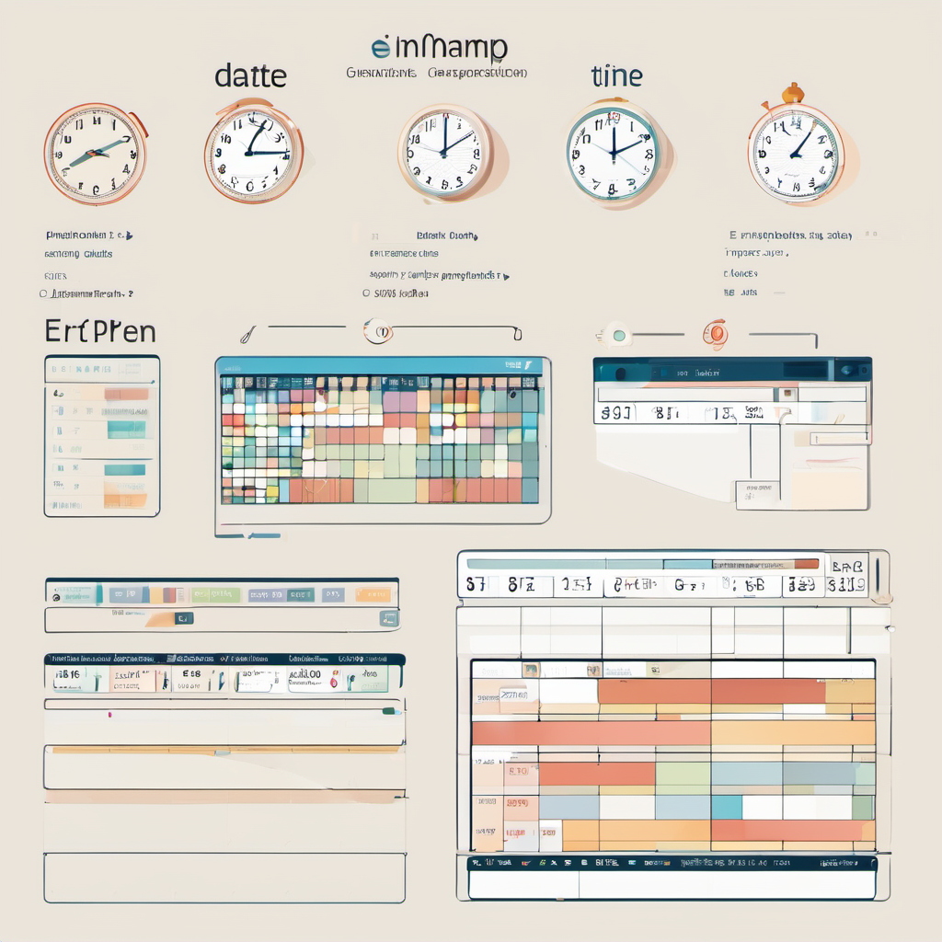
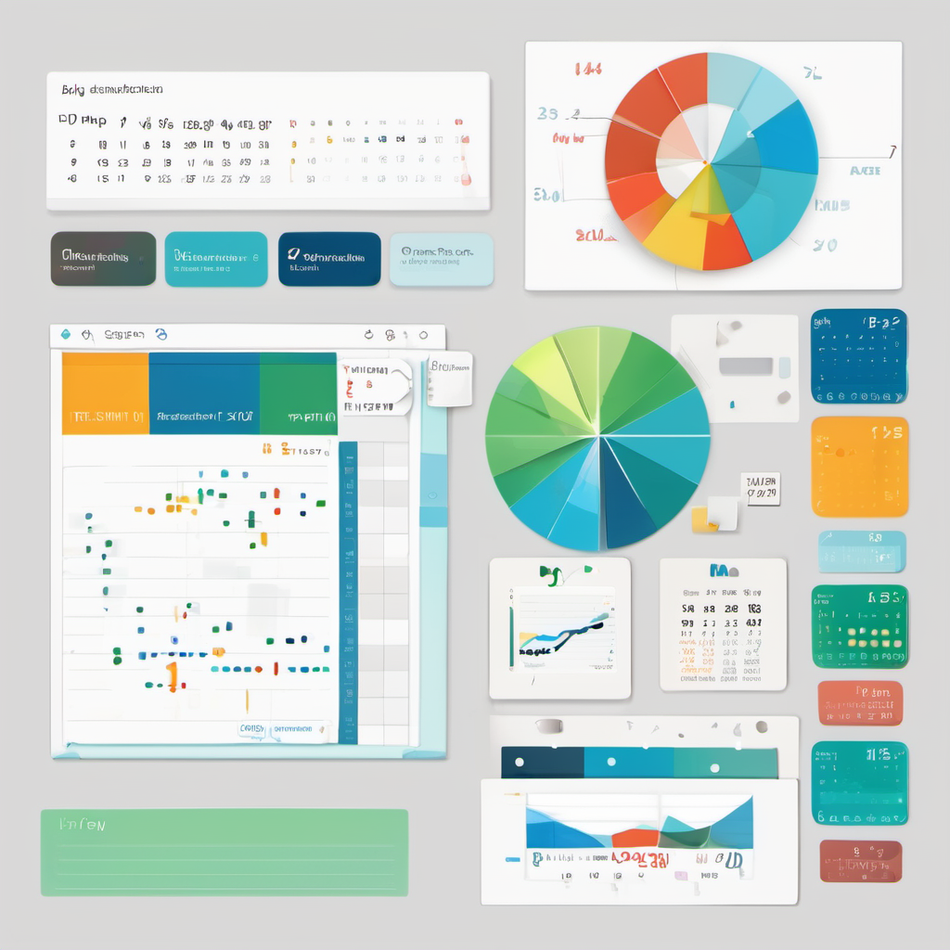
Notes:
Let's kick things off with the basics. Date and time data types come in various forms: date, time, datetime, and timestamp.

Slide 4
The date data type is a type of data used in programming and databases to represent dates. It typically stores information about a specific calendar date, including the day, month, and year. This data type allows for operations such as comparison, addition, and subtraction of dates, making it useful for tasks involving scheduling, time-sensitive calculations, and data organization.
Structure : YYYY-MM-DD format
Date Data Type
Examples:
Scheduling Appointments: Date data types are crucial for scheduling appointments and events. For instance, in a calendar application, the date data type allows users to input appointment dates, ensuring accurate representation and management of scheduled events.
Financial Transactions: Date data types play a vital role in recording transaction dates in financial systems. For example, in a banking application, the date data type enables accurate tracking of when transactions occur, facilitating auditing, reporting, and analysis of financial activities.
Notes:
1- Date data type: Represents calendar dates for organizing and managing time-related data.
2- Stores day, month, and year for efficient manipulation in programming and databases.
3- Enables comparison, addition, and subtraction for scheduling and calculations.
4- "Essential for tasks requiring time-sensitive organization and data management

Slide 5
The Time data type represents a specific point in time, typically measured in hours, minutes, seconds, and sometimes milliseconds. It is commonly used in programming and databases to store and manipulate time-related information, such as event scheduling, tracking durations, or managing time intervals.
Structure : HH:MM:SS format
Time Data Type
09:25:15
Examples:
Restaurant Reservations: Time data type enables customers to book tables for specific times, aiding restaurants in managing reservations effectively.
Bus Schedules: Time data type helps in displaying and updating bus schedules accurately, ensuring passengers have reliable information for planning their journeys.
Notes:
"Time data type: Precision in temporal data."
"Manage time efficiently with this data type."
"Capture moments accurately with Time data type."
"Time data type: Essential for time-related operations."
"Simplify time management in code with Time data type."
"From scheduling to tracking, Time data type has you covered."
"Time data type: Your tool for precise time tracking."
"Stay on schedule with Time data type."
"Time data type: Streamlining temporal operations."
"Unlock time-related functions with Time data type."

Slide 6

The DateTime data type is used to represent a specific date and time, typically including information about the year, month, day, hour, minute, second, and sometimes milliseconds. It is commonly utilized in programming and databases for tasks such as recording timestamps, scheduling events, and performing date arithmetic.
Date Time Data Type
Examples:
Flight Booking System: DateTime data type is used to manage departure and arrival times of flights, ensuring accurate scheduling and booking.
Financial Transactions: DateTime data type is employed to timestamp transactions in banking systems, facilitating precise record-keeping and audit trails.

Slide 7
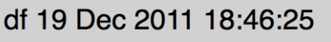
The Timestamp data type represents a specific moment in time, often measured in seconds or milliseconds from a predefined starting point, such as the Unix epoch. It is commonly used in databases and programming for accurate timekeeping and data tracking.
Combination of date and time components
Timestamp Data Type
Examples:
Financial Analysis: Timestamp data type aids in analyzing stock market data, enabling tracking of price fluctuations and facilitating algorithmic trading.
Environmental Monitoring: Timestamp data type is essential for processing time-series data from environmental sensors, helping researchers track changes in climate variables for analysis and decision-making.

Slide 8
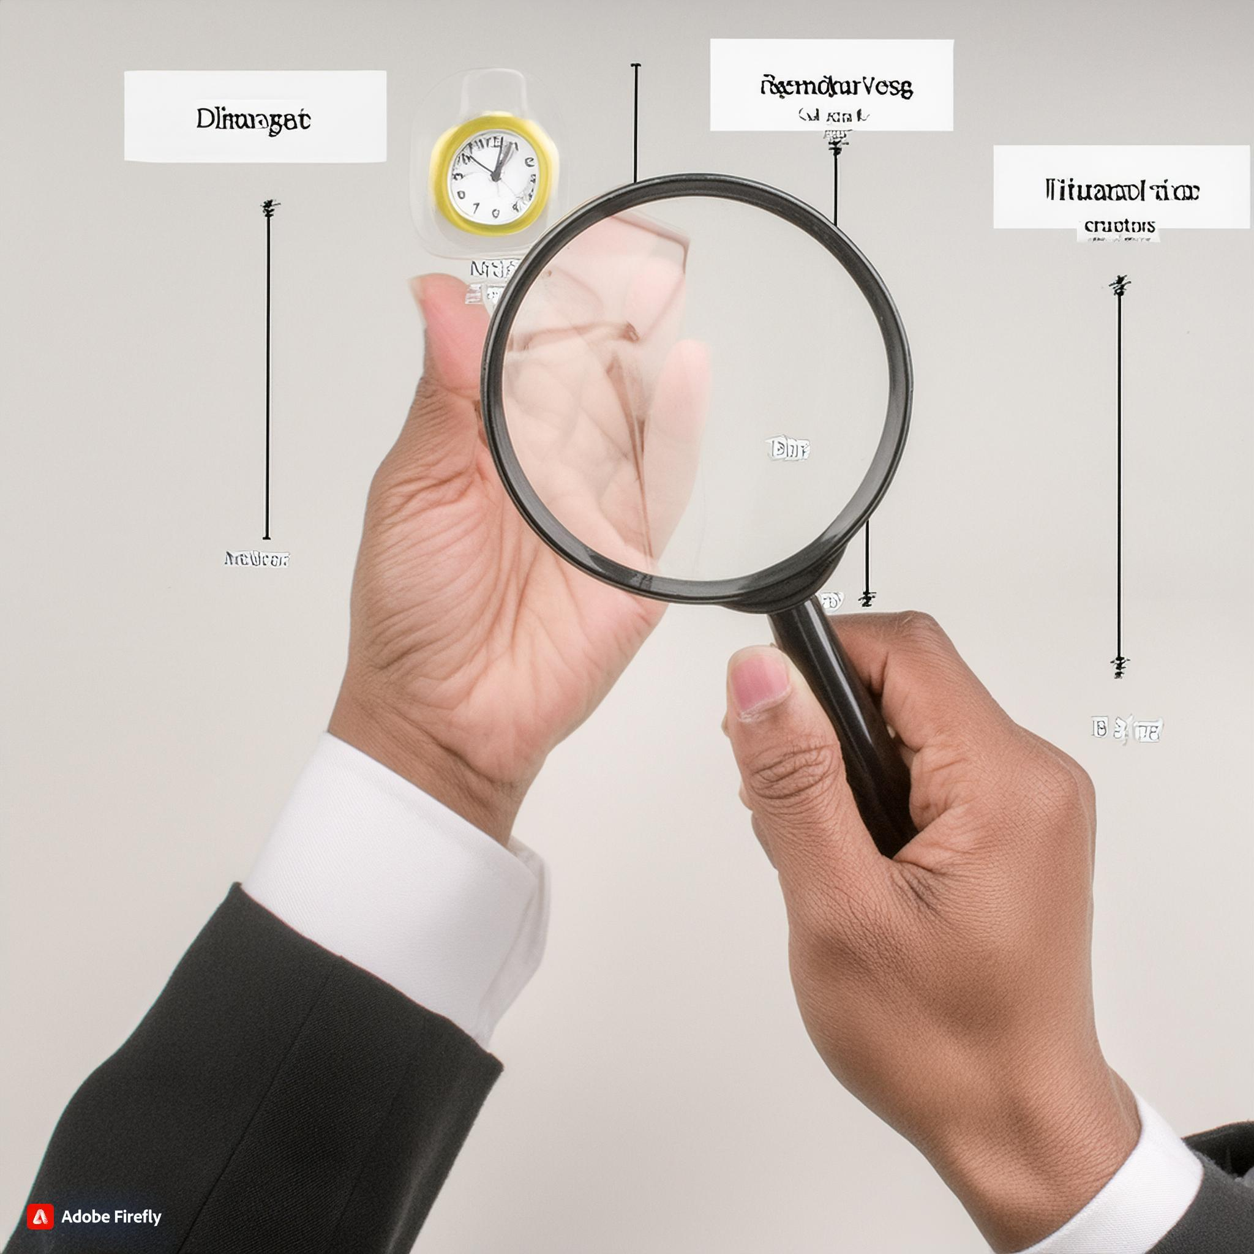
Notes:
Remember, clarity is crucial when working with date and time data. Keep your formats consistent and your code easy to understand.

Slide 9
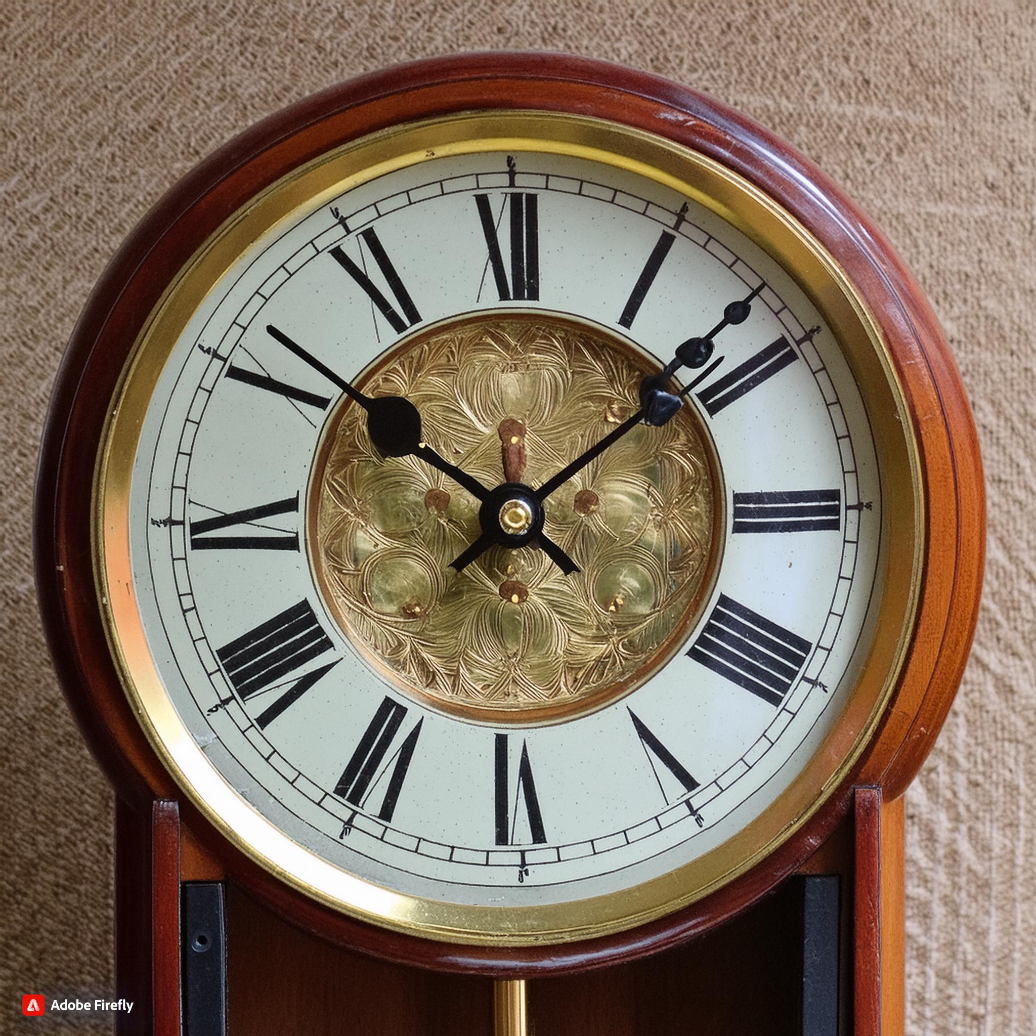
Notes:
And there you have it! A brief overview of date and time data types. Stay curious and keep exploring!

Slide 10

Notes:
Got questions or want to learn more? Drop them in the comments below! Happy coding!

